Slide 1

Delicious Eats at Your Fingertips
Discover a world of culinary delights with our online food delivery service. From local favorites to global cuisines, your next mouthwatering meal is just a click away

Slide 2
TEAM MEMBERS: Manideep(2210030224) Akshitha(2210030442) Abignya(2210030493) Yashwanth(2210030491)

Slide 3
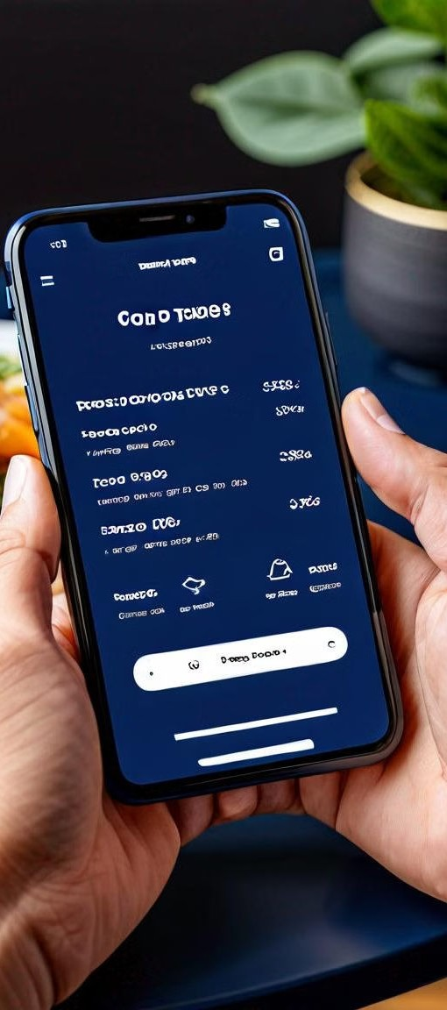
Features that Delight
1 2
User-Friendly Interface
Our intuitive app and website make ordering a breeze, with easy-to- navigate menus and seamless checkout.
Diverse Restaurant Selection
Explore a wide range of cuisines, from classic comfort foods to gourmet specialties, all available for delivery.
3
Real-Time Order Tracking
Stay informed every step of the way with real-time updates on the status of your order.

Slide 4
A Smooth Ordering Experience
Efficient Order Processing
Our streamlined order processing ensures your meal is prepared and on its way to you quickly.
Secure Payment Options
Choose from a variety of secure payment methods, including credit cards, digital wallets, and more.
Contactless Delivery
For your safety and convenience, we offer contactless delivery options for a seamless, touchless experience.

Slide 5


Explore Our Culinary Offerings
1
2
3
Extensive Selection
Browse through a vast array of local and global restaurants, each with their own unique menus.
Dietary Preferences
Filter by cuisine, dietary restrictions, and customer ratings to find the perfect meal for you.
Personalized Recommendations
Our AI-powered suggestions help you discover new flavors tailored to your tastes.

Slide 6
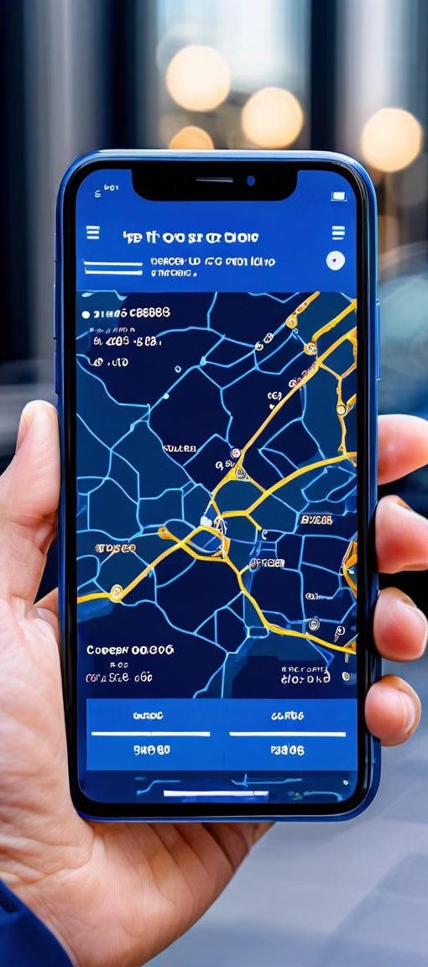
Enjoy the Journey
1
Place Order
Select your favorite dishes and customize your order with ease.
2
Track Delivery
Monitor the status of your order in real-time and receive updates on its progress.
3
Enjoy Your Meal
Savor every bite of your delicious, freshly prepared meal delivered right to your door.

Slide 7
Why Choose Us?
Unparalleled Service
Our team of dedicated professionals ensures a seamless and enjoyable ordering experience every time.
Quality Assurance
We partner with reputable restaurants and maintain strict quality control standards to deliver the best possible meals.
Customer Satisfaction
Our exceptional customer reviews and high ratings speak for themselves, ensuring your satisfaction is our top priority.
Commitment to Sustainability
We're dedicated to eco-friendly practices, including sustainable packaging and carbon- neutral delivery options.

Slide 8
Hungry? Let's Get Started
Order Now
Browse our extensive selection and place your order with just a few taps.
Fast Delivery
Your meal will be prepared and delivered to you quickly and efficiently.
24/7 Support
Our friendly customer service team is available around the clock to assist you.
Rewards Program
Earn points and unlock exclusive benefits with our loyalty program.

Slide 9
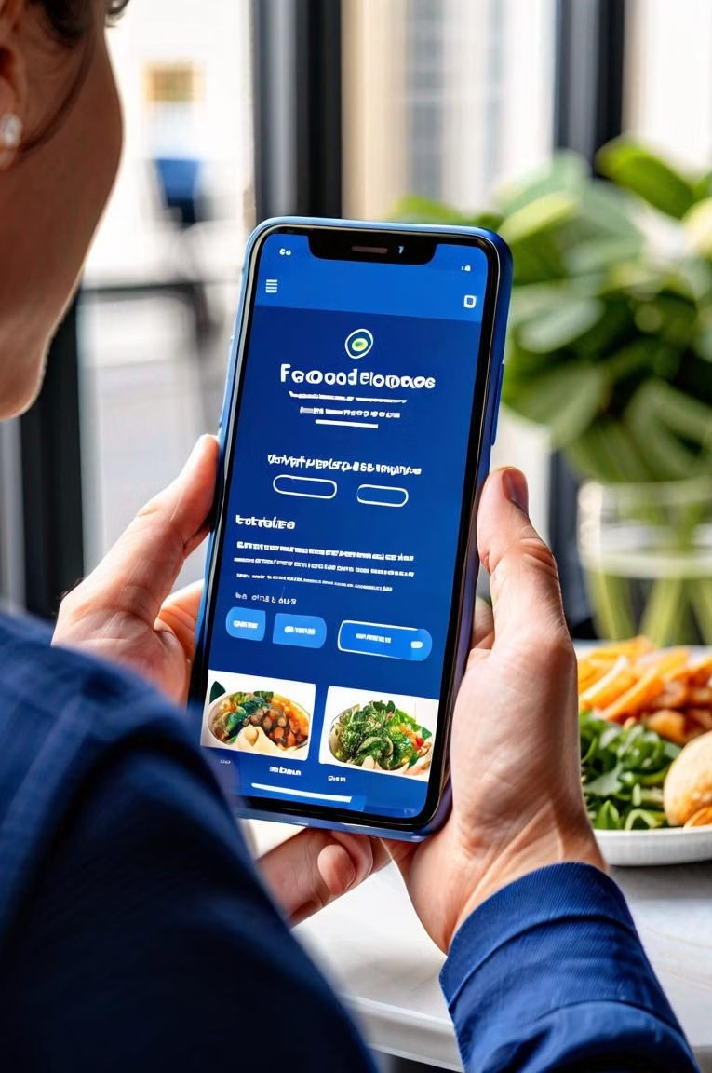
Satisfy Your Cravings Today
Discover the convenience and joy of delicious meals delivered straight to your doorstep. Download our app or visit our website to get started. Your next culinary adventure awaits!

